Slide 1

Brunch
Fast front-end web app build tool with simple declarative config and seamless incremental compilation for rapid development.
Made By – Malav Patel

Slide 2
Why Brunch ?
Brunch was built with two things in mind: speed and simplicity.
You will find that the typical config of a Brunch application is an order of magnitude simpler, compared to Webpack, Grunt, or Gulp.
And that the time it takes to perform a fresh compilation? It's times faster.
Even more so if you run the watcher — it will only rebuild what was changed, not everything, getting you incremental compilations in under 500ms.
Besides configs, brunch is also simpler in terms of commands.
Grunt / Gulp commands replicate all plugins it loads.
Brunch always has three commands: new, build and watch.
Build / watch commands may receive optional production flag which will tell Brunch to optimize assets, javascripts and stylesheets.
Small configuration
Three simple commands
Productivity and happiness
Plugins
Skeletons

Slide 3
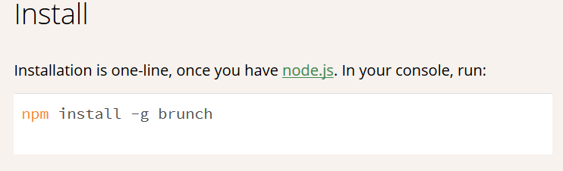
How To Use Dead Simple

Slide 4
Step 1 : - brunch new project –s es6
The Above command will make a new directory called project
Then after making a directory it will download or git clone the skeleton.
We provided a skeleton to use es6 for our code.
But it will download packages for brunch-babel which is customised to use settings provided in brunch-config.js

Slide 5
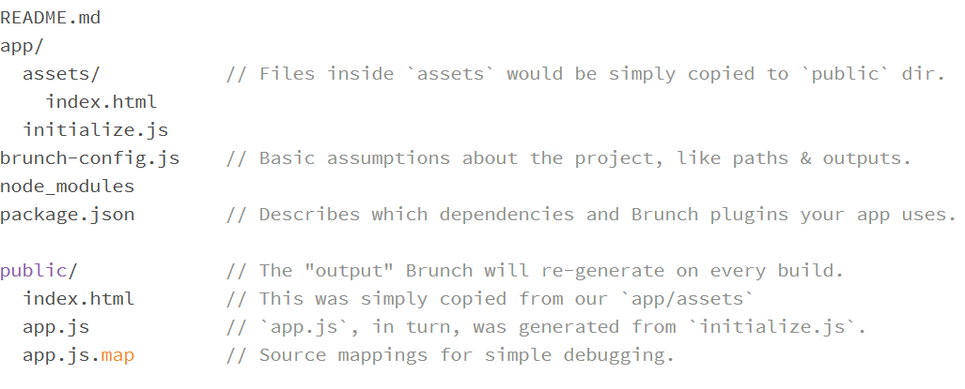
ES6 Skeleton structure.

Slide 6
Step 2 :- Modify the skeleton / make your app
In the app directory we will add some code
The Code added will be combined into a single file app.js and the all the css files into app.css
The assets will be same as it is in public output folder but will contain links for all the complied files.
We can customize the way our final output is done we can transpile our code use sass / coffee script and more and we get out deployable version of output.

Slide 7
Step 3 :- brunch build
As explained this command will build the code and give us the output
Simple as it sounds we can use - - production to get a minified version of the code to save traffic cost and optimize the speed.
And this gives us a good uglyfied obstructed code for deployment.

Slide 8
Step Intermediate :- brunch watch --server
This Command can be use while in app development to build the
Code every time there is change in directory or file saved to reflect those changes into the browser
On change the server is also refreshed.
So it easy to make the code and forget about running commands.

Slide 9
Best Feature I like is that
We can use require in the browser so we get out functionality
We can split our code into modules and work on each component individually and import the required code when needed
The Brunch has many plugins & skeleton to use and start the project with
If I wanted to create react application ill use skeleton provided for react and just go for it if a skeleton is not available ill use plugin to get the feature.

Slide 10

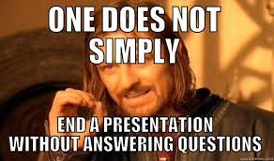
Difference Between other

